Slide 1


Bayesian inference of material culture phylogenies using continuous traits from the archaeological record
Ben Marwick
Department of Anthropology, University of Washington, Seattle, USA
David N. Matzig
Felix Riede
Department of Archaeology and Heritage Studies, Aarhus University, Denmark
Cultural Evolution Society Conference,
Sapporo, June 2021
Code & data online at https://github.com/benmarwick/CES2021
Notes:
The unceded lands and traditional home of the Coast Salish people, the traditional home of all tribes and bands within the Duwamish, Suquamish, Tulalip and Muckleshoot nations.
Notes: https://docs.google.com/document/d/1Gt_N7Te-f8NoXmJF4W19W7HSuLEeBuXHxniqysrNLIg/edit

Slide 2
Population and tree thinking
Why tree thinking is niche in archaeology?
Tripartite model of Bayesian inference of phylogenies
Artefact shape as transmittable variation
Case study of ‘Arrows of Power’ in north-west France, southern Britain and Denmark, 2500–1700 BC

Slide 3
Population thinking and Tree thinking
Notes:
The twentieth century saw two modes of thinking spread through biological systematics: population thinking and tree thinking.
Population thinking replaced typology or essentialism. In simple terms, an essentialist sees individual variation within a species as error. The population thinker rejects the idea that species have “types” or “natural states”. We see this in archaeology in writing about spectrums of variation in settlement systems, mobility patterns, technological strategies, etc.
Tree thinking is the phylogenetic counterpart to population thinking, bringing an evolutionary perspective to systematics. It may be contrasted with “group thinking,” (each member of a particular group as an independent replicate, rather than connected by ancestry and descent) and “developmental thinking” (linear histories, without divergence and branching)

Slide 4
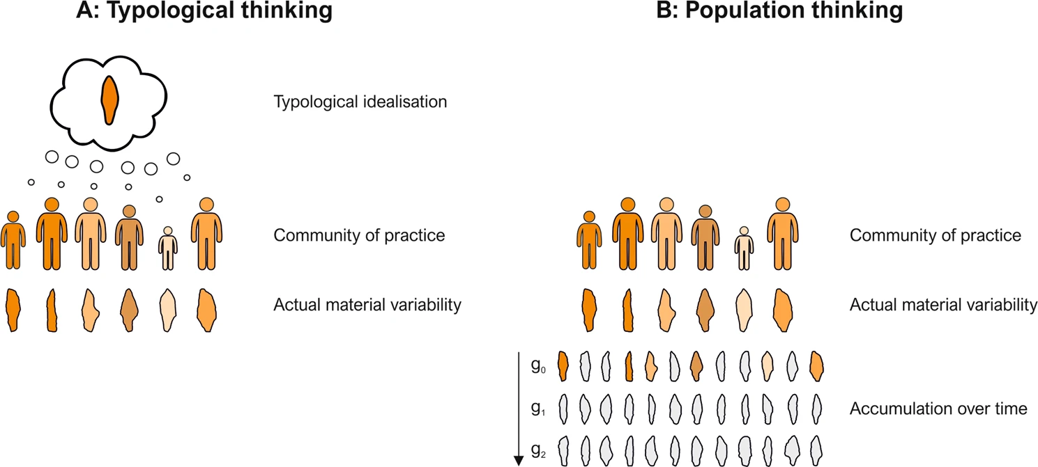
Riede, F., Hoggard, C., & Shennan, S. (2019). Reconciling material cultures in archaeology with genetic data requires robust cultural evolutionary taxonomies. Palgrave Communications, 5(1), 1–9.
Notes:
Here’s a schematic contrasting typological thinking in archaeology with population thinking. We can see how typological thinking tends to neglect the reality of archaeological variation. Most modern archaeological scientists using empirical quantitative methods are using population thinking.

Slide 5
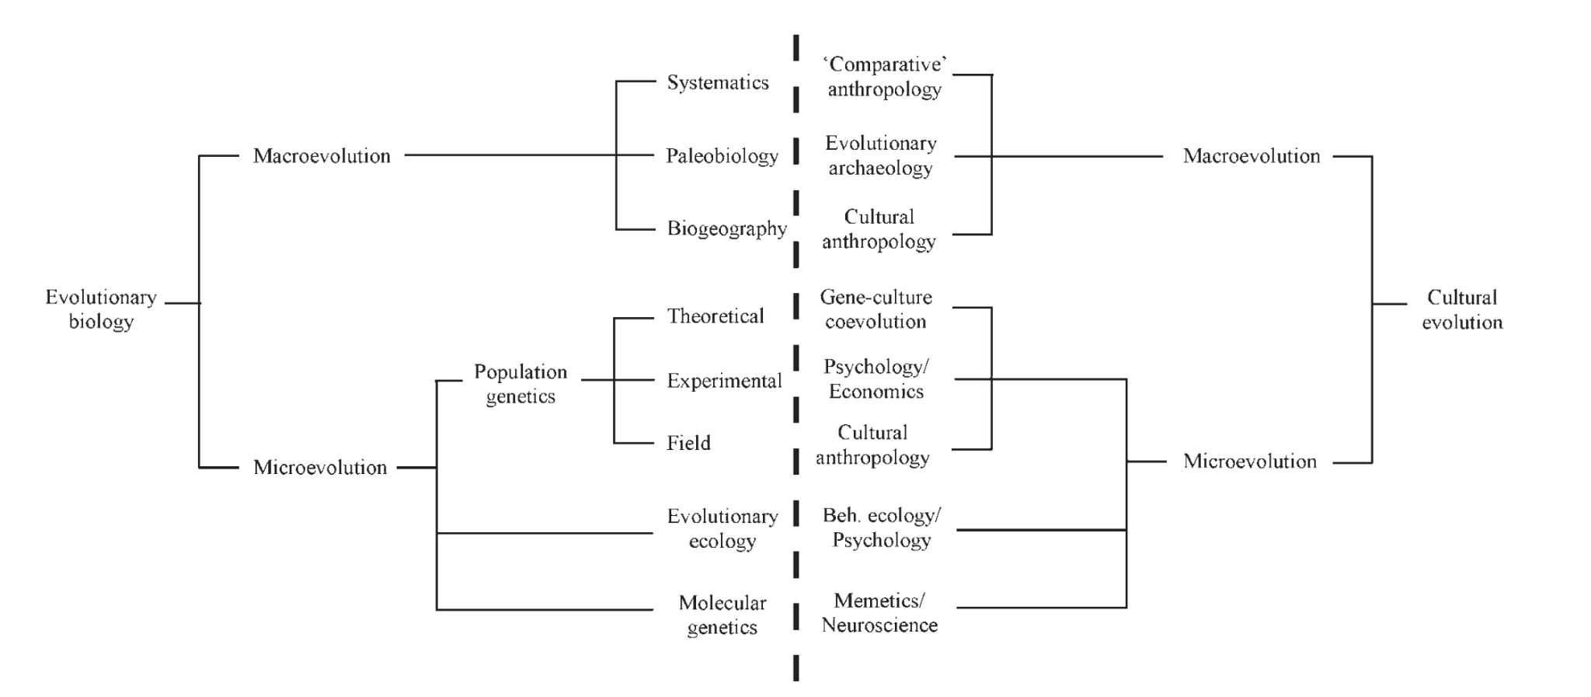
↑ Works well with sparse & diachronic data Tree-thinking about descent
↓ Works well with dense & temporally shallow data Population-thinking about transmission biases
Mesoudi, A., Whiten, A., & Laland, K. N. (2006). Towards a unified science of cultural evolution. Behavioral and Brain Sciences, 29(04), 329–347.
Notes:
And here is a schematic showing Alex Mesoudi et al’s map of cultural evolution fields and evolutionary biology fields, with our annotations to show where we think tree- and population-thinking have the most to offer.
This schematic highlights the inspirations we may take from palaeobiology, including the transfer of emerging methods such as the Bayesian analysis of continuous traits.

Slide 6
But why is tree thinking niche in
archaeology?
Notes:
Let’s have a quick look at some options

Slide 7
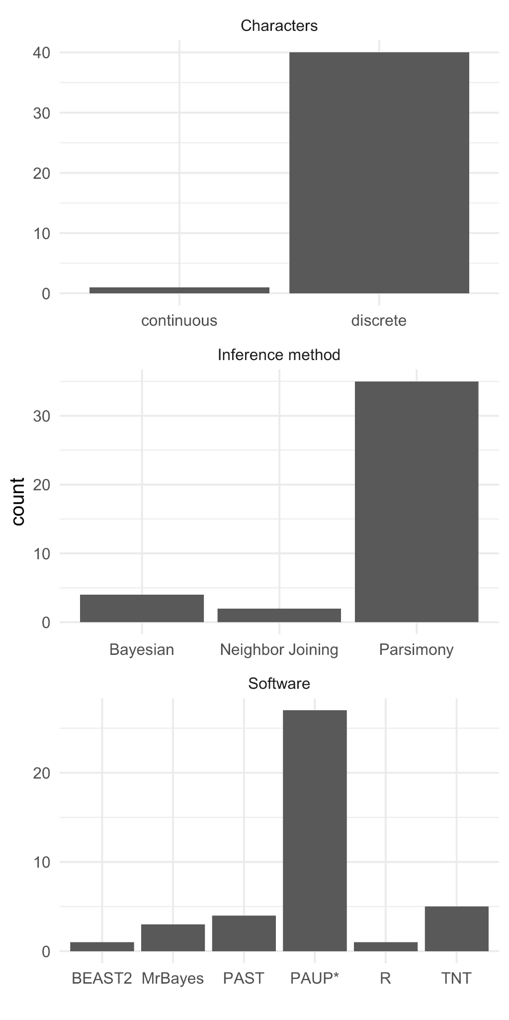
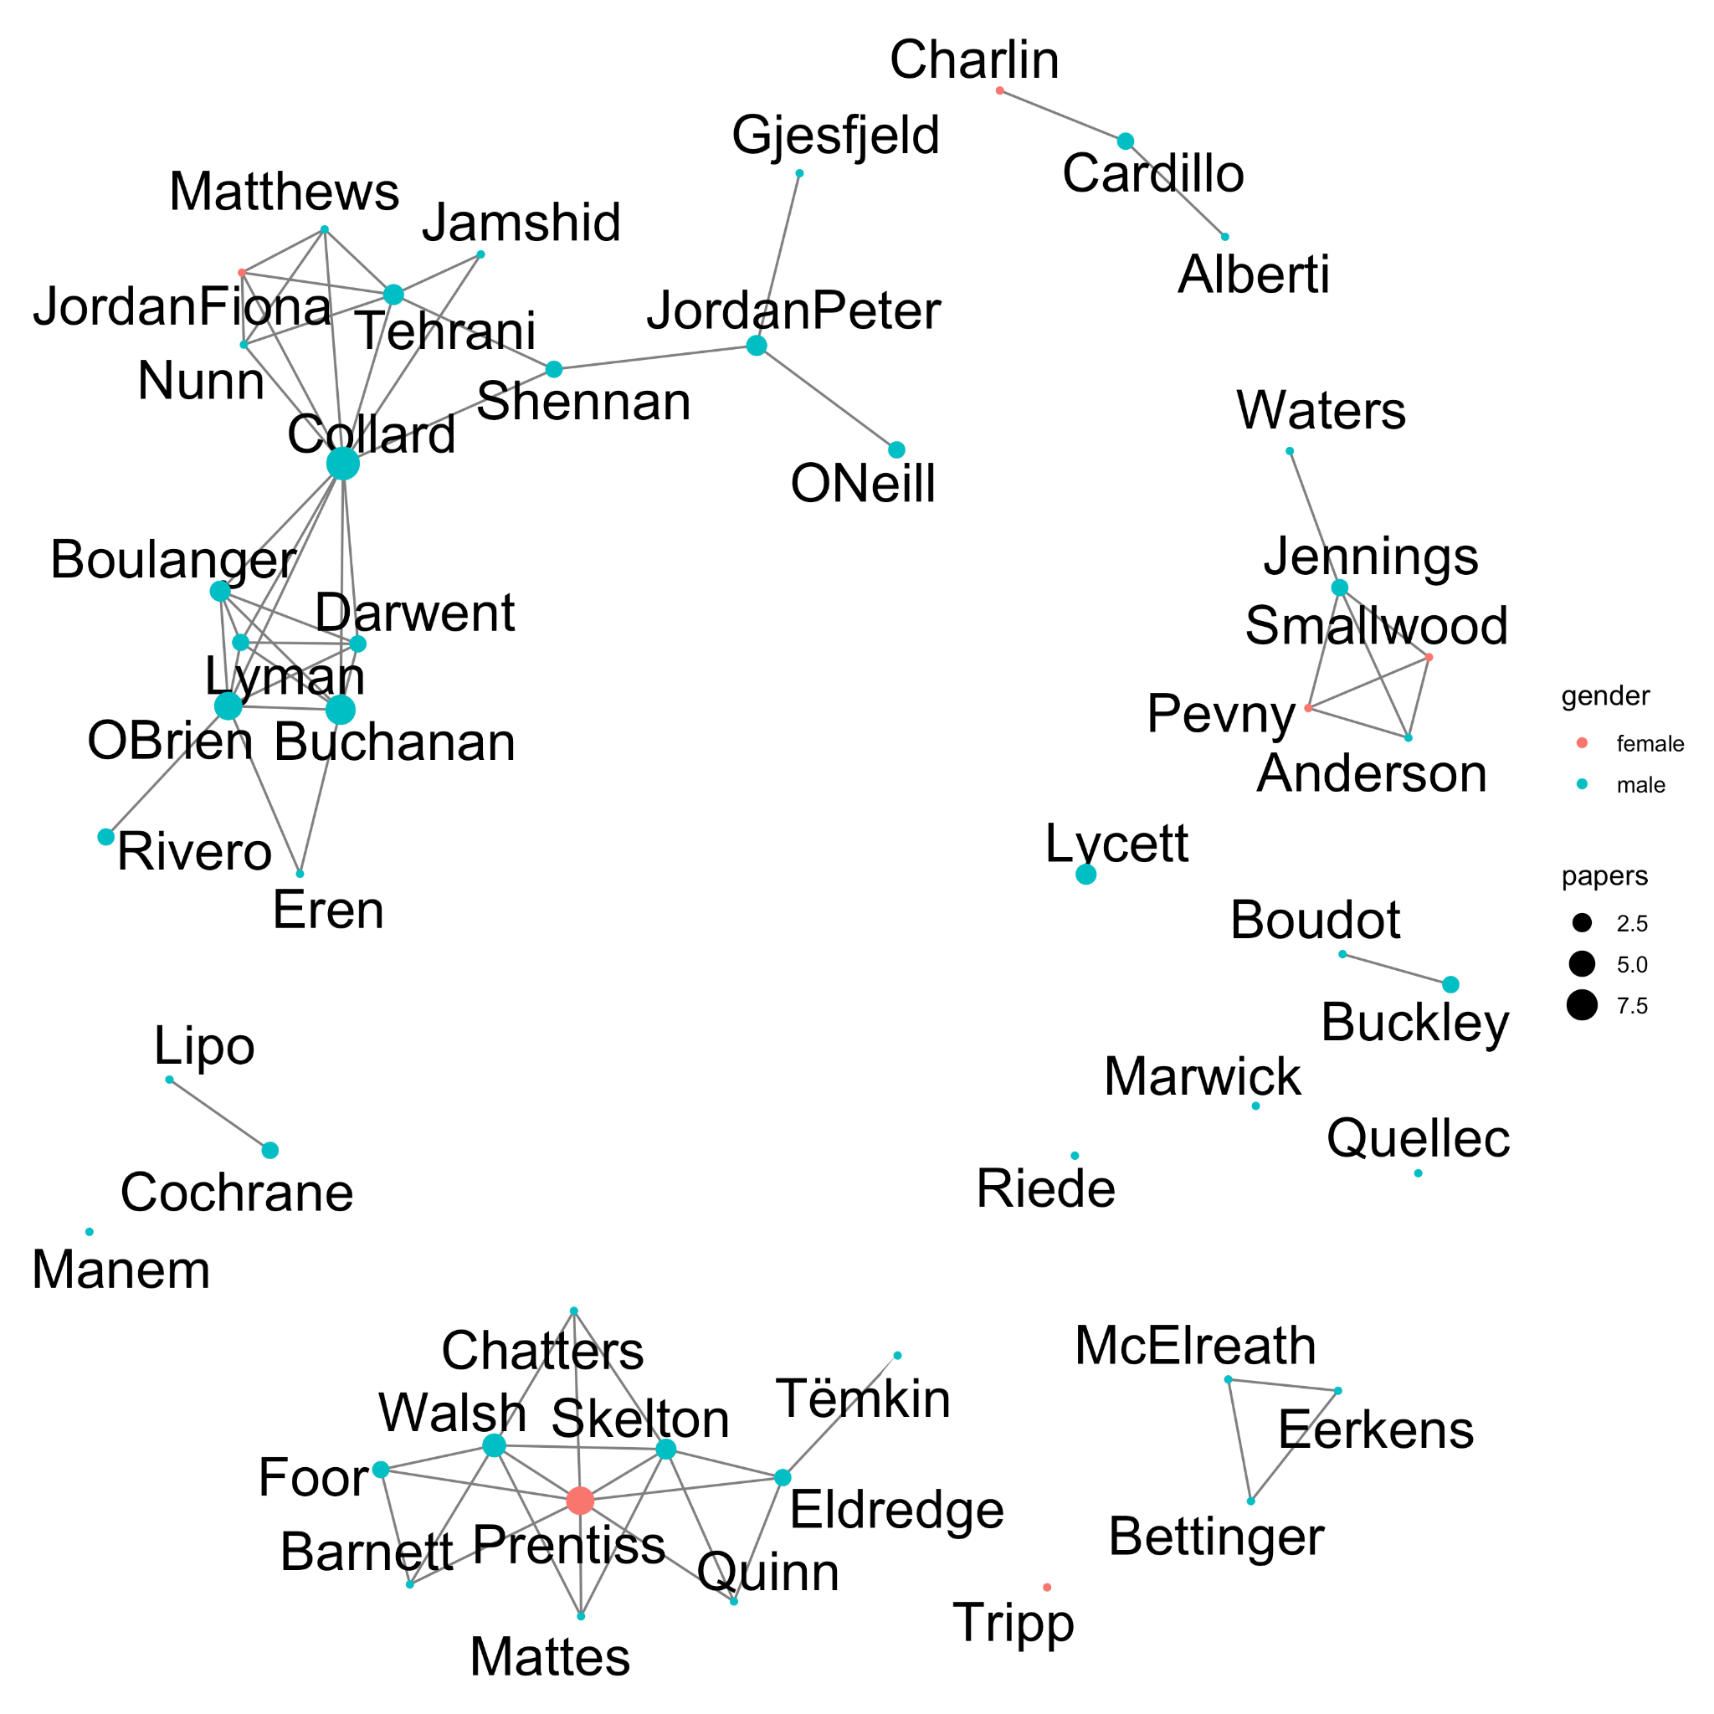
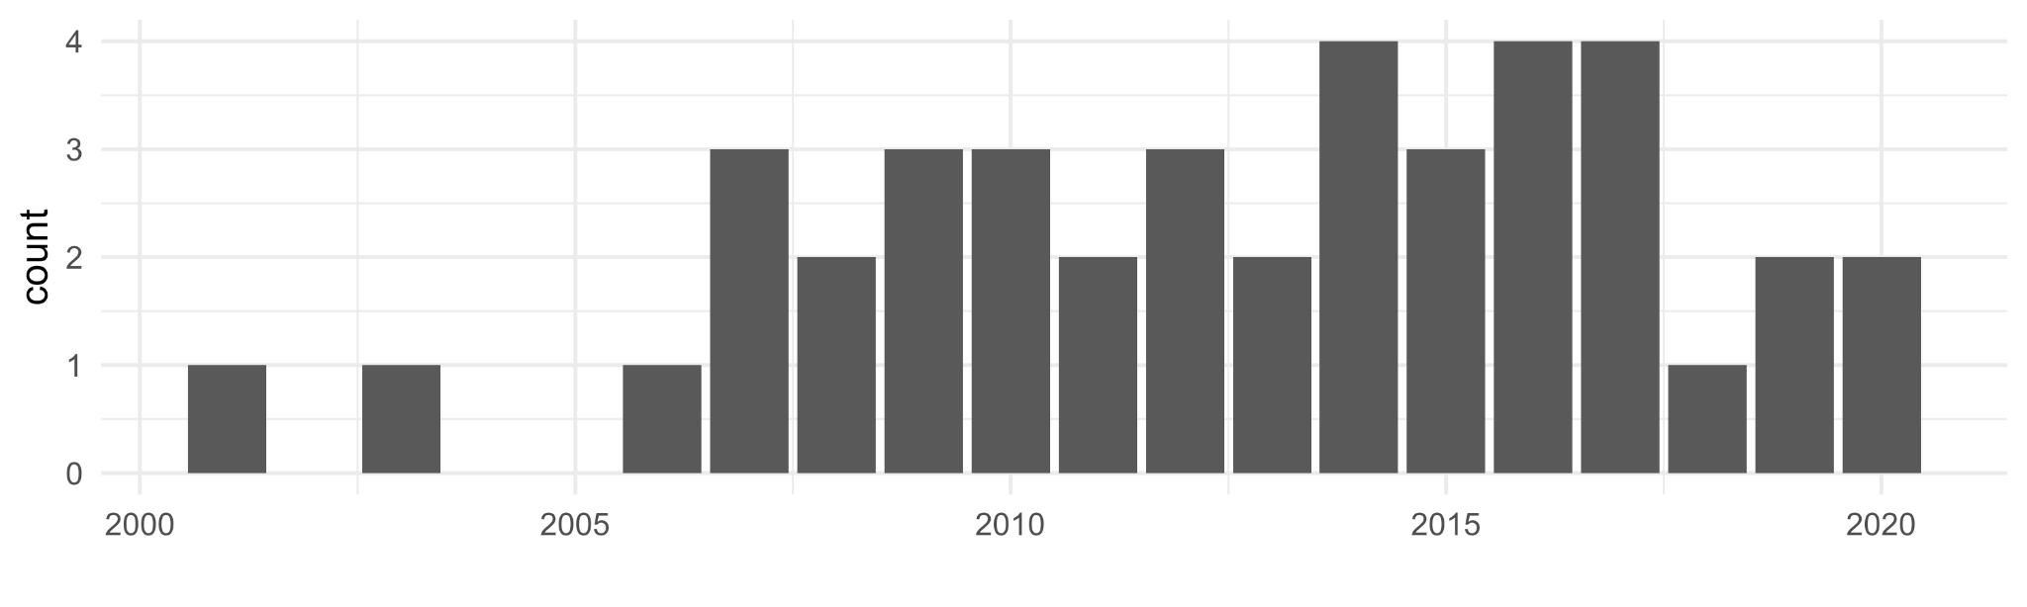
Tree thinking in archaeology: 41 papers by 48 authors, published 2001-2020, presenting original phylogenetic studies of archaeological material culture data,
Notes:
Here is a brief literature review to investigate this question. We see discrete characters, parsimony methods, and PAUP* really dominate the archaeological literature.
The relatively low diversity in methods may also partly explained by the co-authorship network, two groups are producing most of the papers: O’Brien et al and Prentiss et al. Nearly all the papers coming from those groups are using parsimony with discrete variables and PAUP*.
Also note that 90% of authors are male, just four are women. Not shown here is that the geography of the case studies is quite restricted, lots of North American datasets. A shift to FAIR methods (finable, accessible, interoperable and reusable), such as the use of open source software, may help to diversify the field,
Our main point here is that cultural phylogenetics has been dominated by just a few groups and methods that are no longer state-of-the-art in phylogenetics in general and cultural phylogenetics in particular. This may be one of the reasons that tree-thinking is not widespread in archaeology.

Slide 8
Tripartite model of Bayesian inference of phylogenies
Notes:
So what we’d like to do here is sketch out some new ways of doing tree-thinking that we’ve seen emerging in palaeontology that overcome some of the limitations of the entrenched approaches in archaeology. Our goal is to introduce some ideas that might broaden the relevance and appeal of tree-thinking in archaeological science.

Slide 9
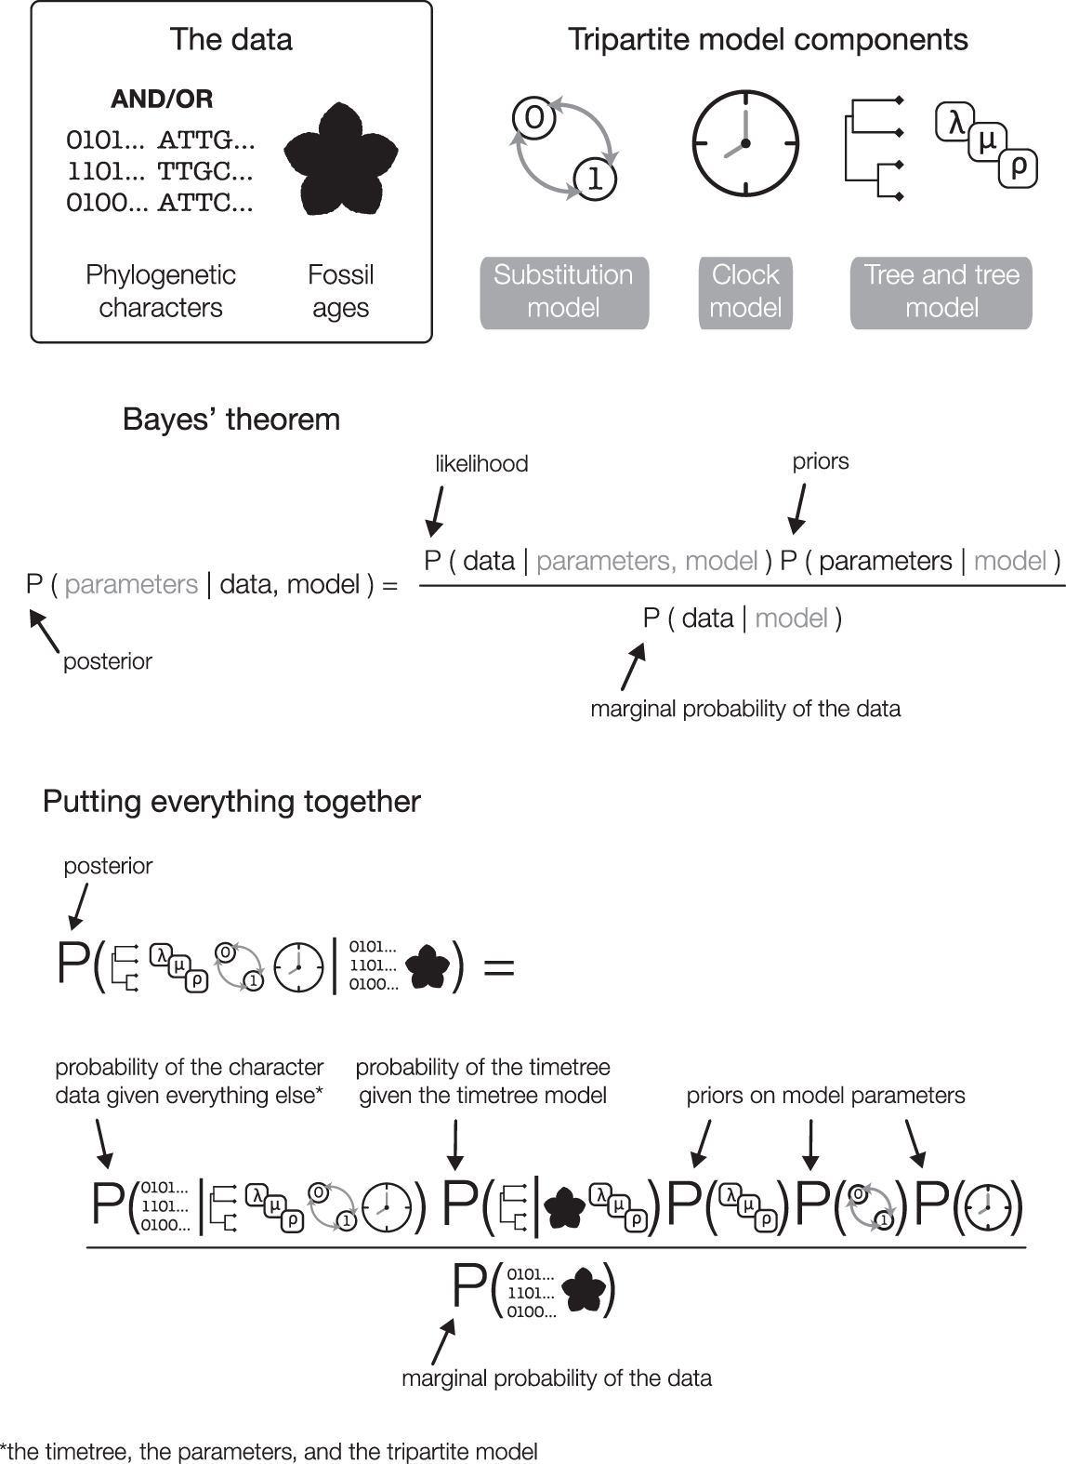
Warnock, R. C. M., & Wright, A. M. (2020). Understanding the Tripartite Approach to Bayesian Divergence Time Estimation. Elements of Paleontology. https://doi.org/10.1017/9781108954365
Notes:
The most profound development, in palaeontological phylogenetics, in our view, is this tripartite model of Bayesian inference.
Bayesian approaches present a robust and satisfying way of handling data and uncertainty, so that there are good analytical reasons to make the shift from parsimony, which has dominated the archaeological literature, to Bayesian approaches

Slide 10
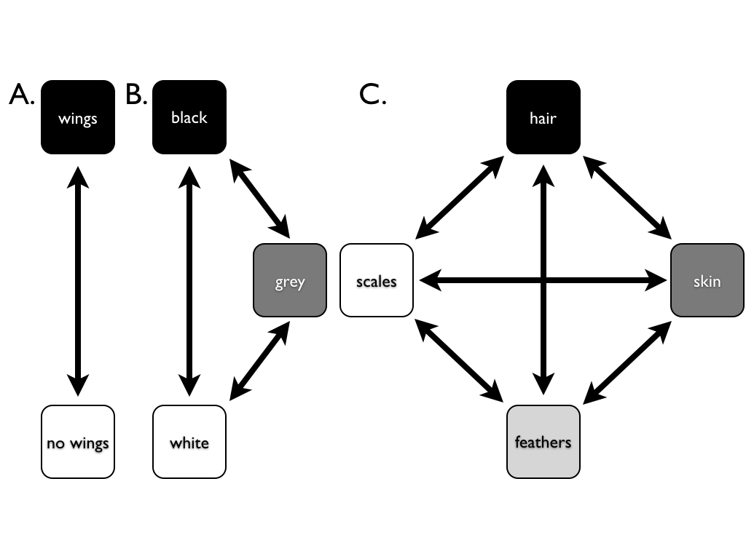
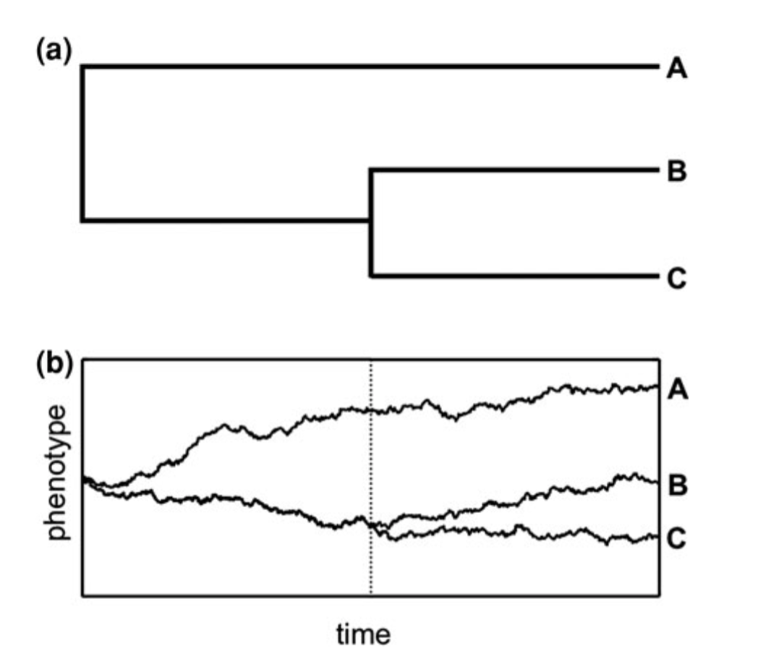
Discrete - morphological Mk
Extended Mk
Continuous traits Brownian motion
Ornstein–Uhlenbeck (OU)
a small number of exotic variations
Warnock, R. C. M., & Wright, A. M. (2020). Understanding the Tripartite Approach to Bayesian Divergence Time Estimation. Elements of Paleontology. https://doi.org/10.1017/9781108954365
Notes:
Substitution models describes the process the researcher believes generated the character data. For archaeologists we have two main sets: discrete and continuous, and several variants of each
Images from https://www.researchgate.net/publication/270453395_A_Primer_on_Phylogenetic_Generalised_Least_Squares, https://lukejharmon.github.io/pcm/chapter7_introdiscrete/

Slide 11
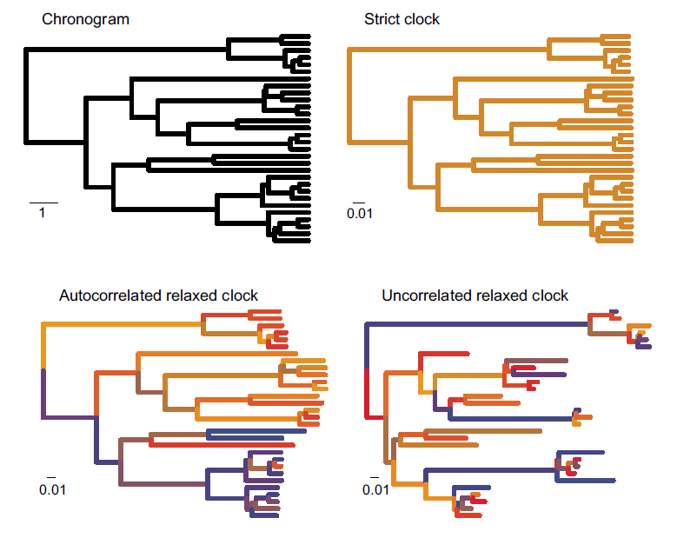
Strict (or global) clock
Relaxed clock:
Uncorrelated clock
Autocorrelated clock
Local clock
Mixture models, etc.
Useful for identifying archaeological episodes of technological innovation or stasis
Warnock, R. C. M., & Wright, A. M. (2020). Understanding the Tripartite Approach to Bayesian Divergence Time Estimation. Elements of Paleontology. https://doi.org/10.1017/9781108954365
Notes:
Clock models describes the manner in which the researcher believes rates of evolution are distributed across the tree. There are two main groups: strict and relaxed. We can see the example trees here showing some of the variants of relaxed clocks.
Image from https://dwbapst.github.io/PaleoSoc_phylo_short_course_2019/articles/module_07_TripartiteModel2_clock_models/Clock_models_for_character_data.html and https://doi.org/10.1111/mec.12953

Slide 12
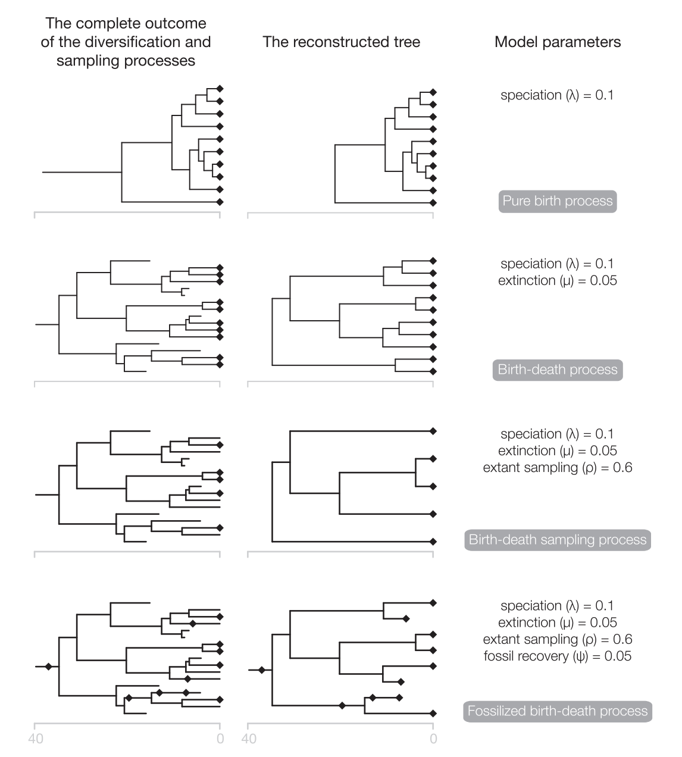
Useful for evaluating assumptions about cultural change and the archaeological record
Also: skyline, multi-species coalescent model
Warnock, R. C. M., & Wright, A. M. (2020). Understanding the Tripartite Approach to Bayesian Divergence Time Estimation. Elements of Paleontology. https://doi.org/10.1017/9781108954365
Notes:
Tree models describes the extinction, speciation, and sampling events that potentially led to the observed tree.

Slide 13
Artefact shape as transmittable variation
Notes:
So there we have a highly flexible framework for formally modelling tree thinking and evaluating assumptions, which helps us with some of the limitations of maximum parsimony approaches. But what about the constraint of discrete characters as input? Here is one option we’ve been exploring, which is using artefact shape as culturally transmitted information suitable for phylogenetic modelling.

Slide 14
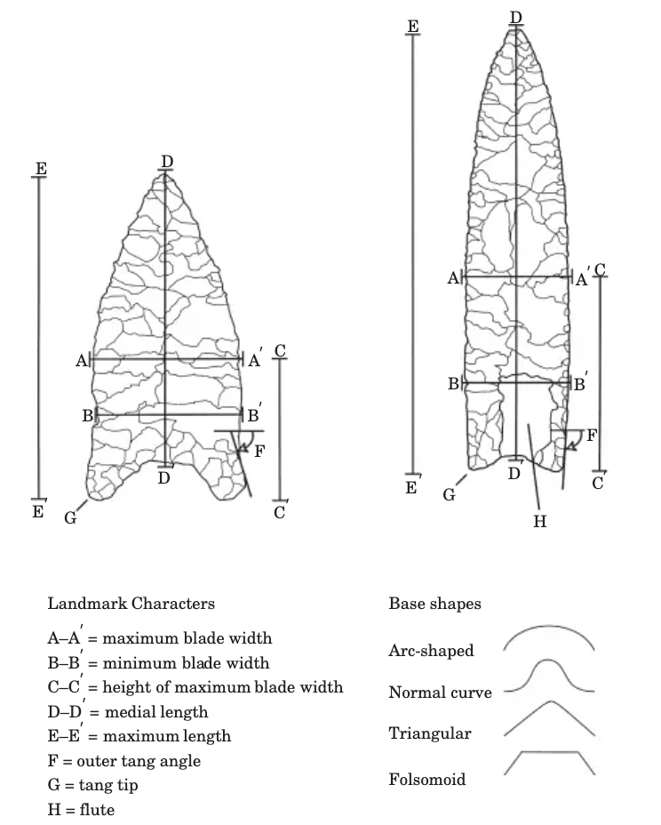
Most previous archaeological and paleontological work arbitrarily discretized continuous characters because of software limitations.
Discrete morphological characters present a non-trivial set of challenges: categorization, ordering, and weighing of discrete character states.
The interpretive nature of the process of character coding has continued to leave major archaeological questions unresolved, and many skeptical about the value of this method.
Archaeologists need to use continuous characters because they can collected more objectively, and do not require ordering of states
Artefact shape has long been recognized as carrying heritable information
O’Brien, M. J., Darwent, J., & Lyman, R. L. (2001). Cladistics Is Useful for Reconstructing Archaeological Phylogenies: Palaeoindian Points from the Southeastern United States. Journal Of Archaeological Science, 28(10), 1115–1136.
Notes:
Artefact shape has long been recognized as carrying heritable information, many of the earlier work in the discipline is predicated on this. However, archaeologists using phylogenetic methods have been limited to discrete characters as inputs into software. This is not consistent with population thinking, present challenges that we never resolve, these may be reasons why tree-thinking has not spread much beyond two groups.
Parins-Fukuchi, C. (2018). Use of Continuous Traits Can Improve Morphological Phylogenetics. Systematic Biology, 67(2), 328–339. https://doi.org/10.1093/sysbio/syx072
Goloboff P.A., Mattoni C.I., Quinteros A.S. 2006. Continuous characters analyzed as such. Cladistics 22:589–601.
Smith U.E., Hendricks J.R. 2013. Geometric morphometric character suites as phylogenetic data: extracting phylogenetic signal from gastropod shells. Syst. Biol. 62:366–385.
Assumptions held by archaeologists doing phylogenetics:
There is enough vertically transmitted shape variation for some artefact assemblages to have a phylogenetic signal.
Some elements of artefact shape variation are highly constrained to function (e.g. mechanical, social), other elements freely drift (we often don’t know which elements are doing what)
Most artefacts are intentionally shaped by their makers, using information transmitted between individuals, and acquired by trial and error (we often don’t know how much of each)
Historically archaeologists have made strong assumptions about artefact shape as resulting from heritable information, many typologies are based on this. Despite this assumption, shape has rarely been quantified and formally modelled as if it did have heritable characteristics. Our aim is to explore the implications of of formalising this assumption.

Slide 15
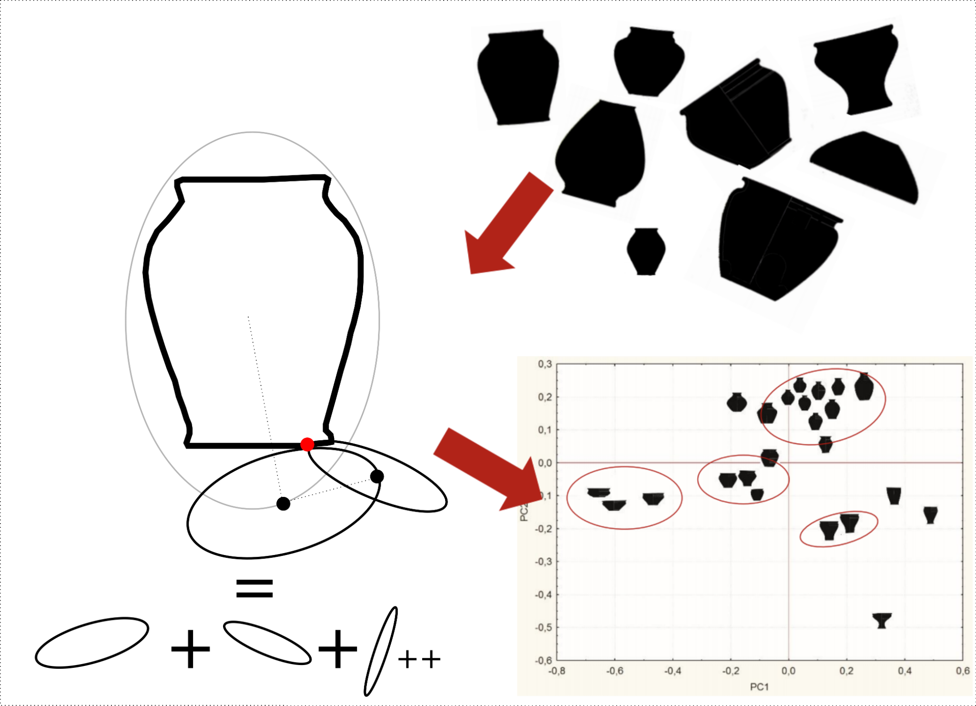
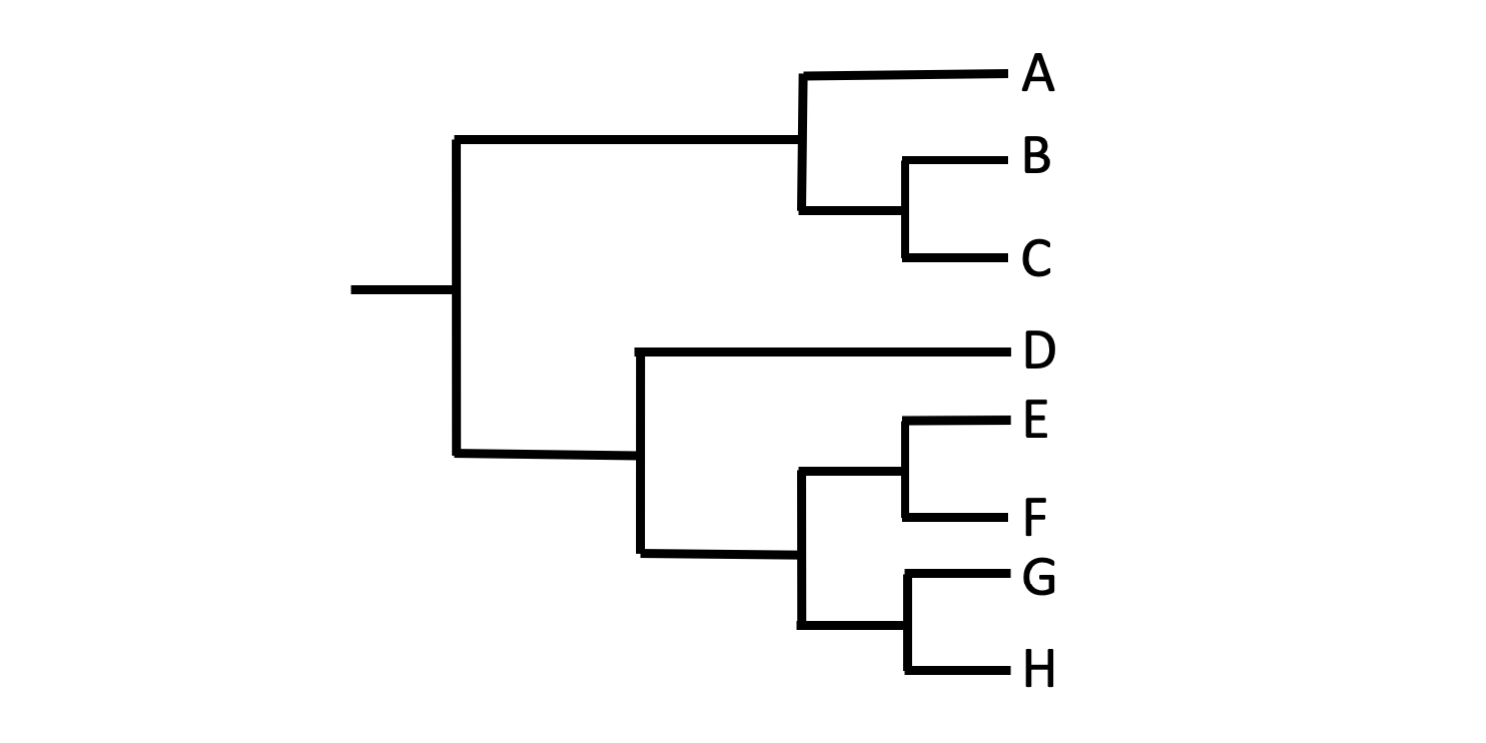
How to convert shape into continuous characters?
Digitize artefact outlines
Elliptical Fourier Analysis
Principal Components Analysis on EF coefficients
PCs are shape variables; the continuous traits for phylogenetic inference
For a recent example in palaeontology, see
Parins-Fukuchi, C. (2021). Morphological and phylogeographic evidence for budding speciation: An example in hominins. Biology Letters, 17(1), 20200754. https://doi.org/10.1098/rsbl.2020.0754
Notes:
Here is our workflow for quantifying artefact shape without discretizing into characters. The key method is EFA, which decomposes the shape into a series of harmonics. We then reduce the dimensionality of these using PCA, and the PCs are shape variables that are the character states for phylogenetic inference. And we cite on the lower right corner a recent palaeolontological paper that did this, using landmarks instead of outlines, as we are.
Images from https://jwilczek.com/teaching/modern-quantitative-methods-and-shape-analysis-in-archaeology/ and https://www.digitalatlasofancientlife.org/learn/systematics/phylogenetics/reading-trees/

Slide 16
‘Arrows of Power’ in north-west France, southern Britain and Denmark, 4500–3700 BP
Notes:
To demonstrate how this kind of tree-thinking can be applied to archaeological questions, we present a brief case study of stone artefacts from the Late Neolithic of western Europe

Slide 17
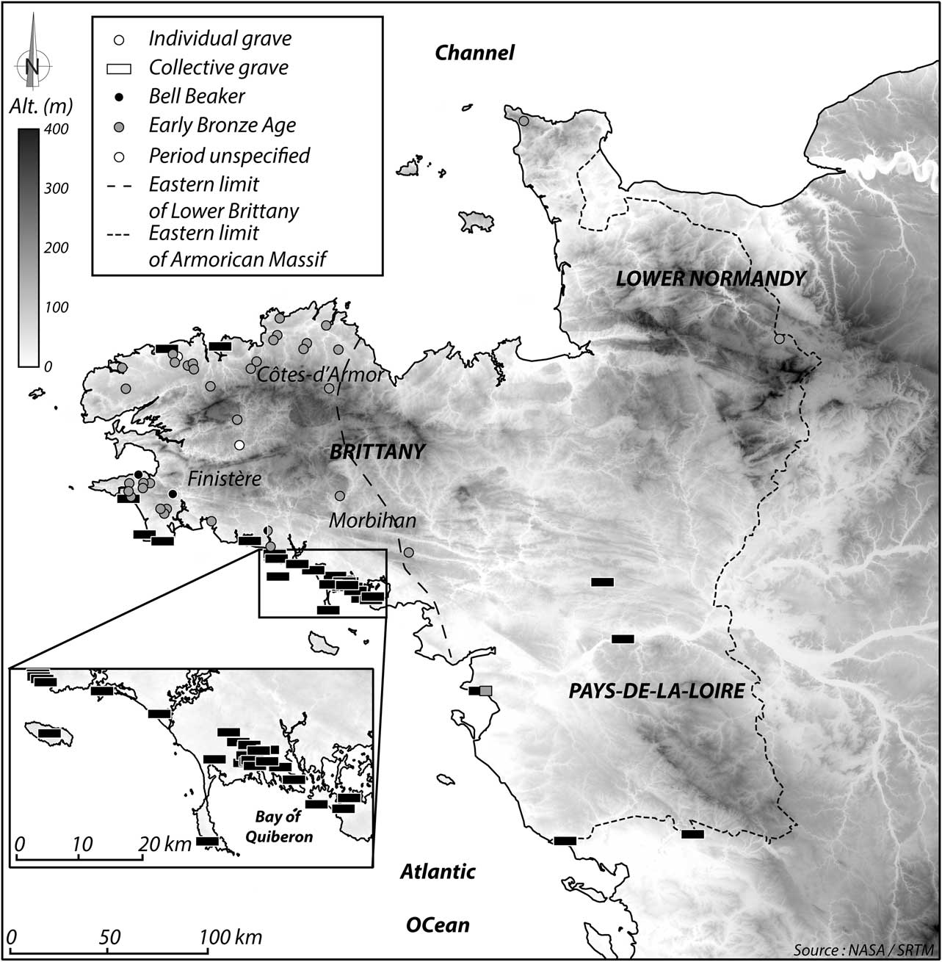
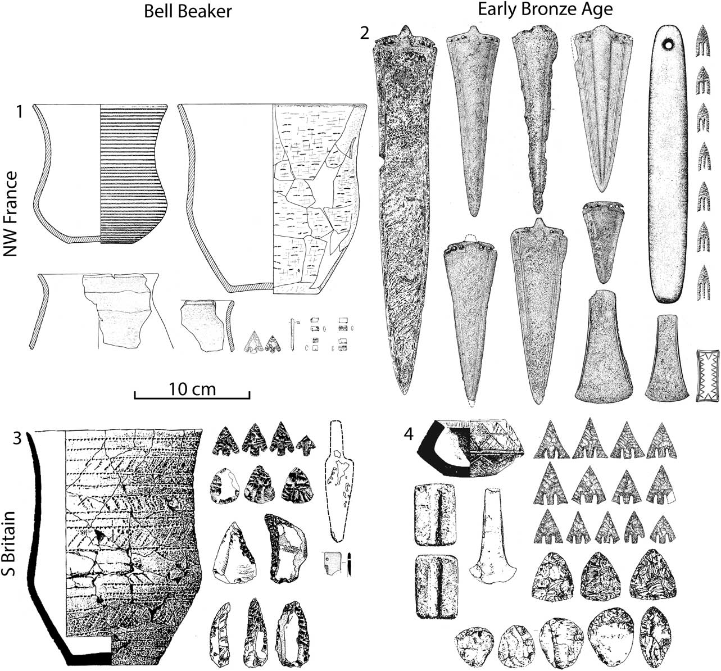
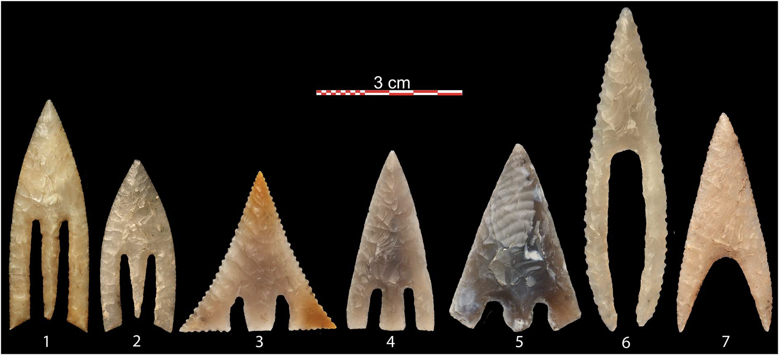
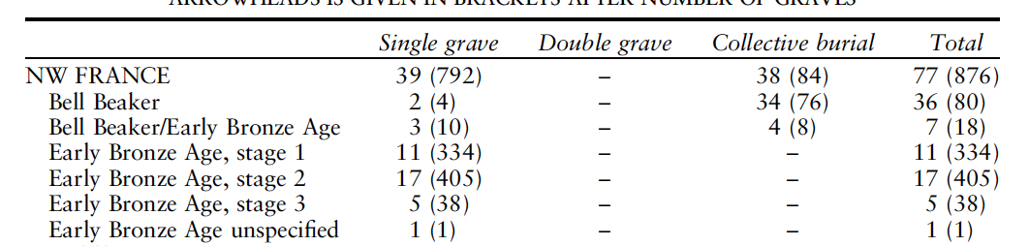
Nicolas, C. (2017). Arrows of Power from Brittany to Denmark (2500–1700 BC). Proceedings of the Prehistoric Society, 83, 247–287. https://doi.org/10.1017/ppr.2017.5
Notes:
The data are the flaked stone artefacts, such as on the lower right, found in Bell Beaker graves in France. Most likely associated with interpersonal combat, and used as ‘sacred’ objects, made for display and enhancing the power of the chiefs.

Slide 18
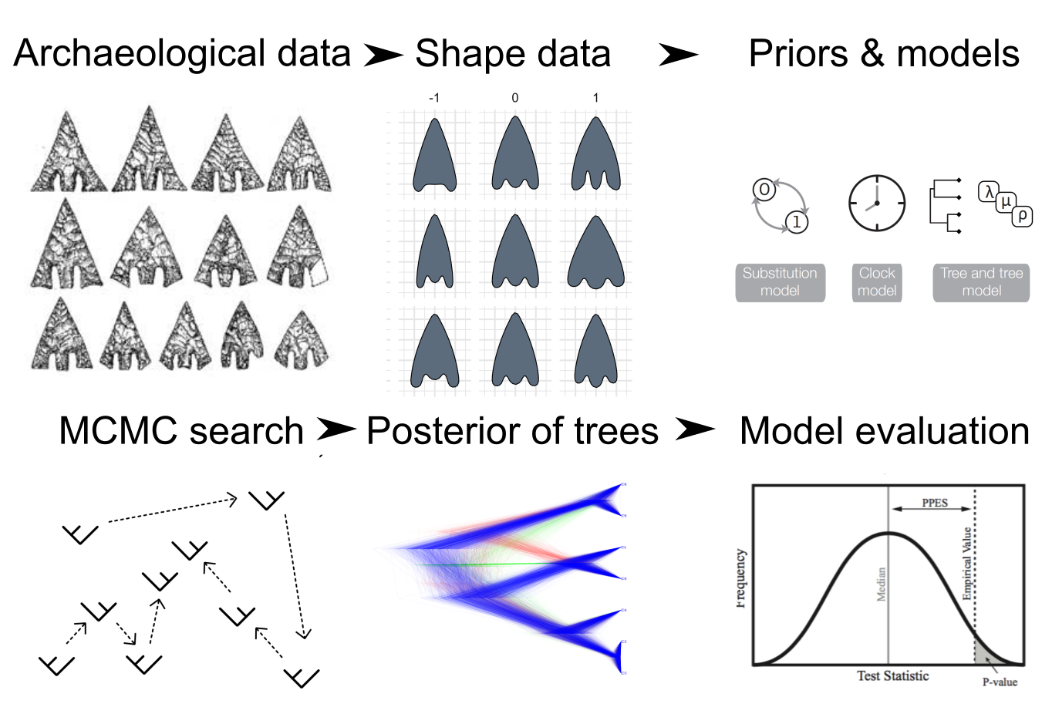
Notes:
From the archaeological data to the shape summaries, we then define our priors and models, and use MCMC to explore the parameter space to find ones that fit well with our data. The output is an posterior distribution of trees, with which we can make inferences and model evaluations

Slide 19
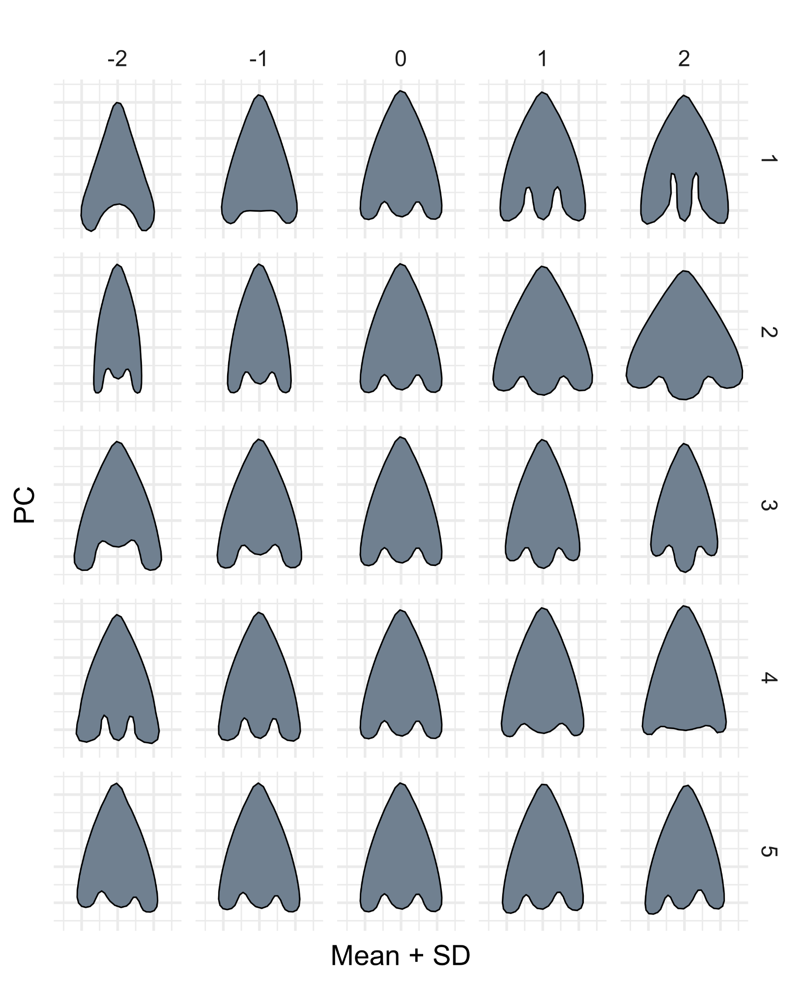
The Principal Components are interpretable as modular shape characteristics
Tang depth
Shoulder width
Tang height
Tang width
Shoulder height symmetry
Notes:
We took images of the arrowheads compiled by Nicholas and applied our shape quantification workflow. The EFA and PCA do seem to capture aspects of shape that are easy to recognise, and could be captured in non-quantitative, discrete state methods. Here we can see the first five principal components extracted from the elliptical fourier analysis. These PCs can be interpreted as shape variables that might be the same as what we’d create if we were making discrete characters.

Slide 20
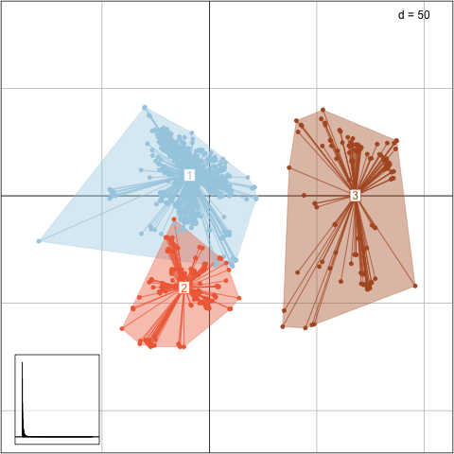
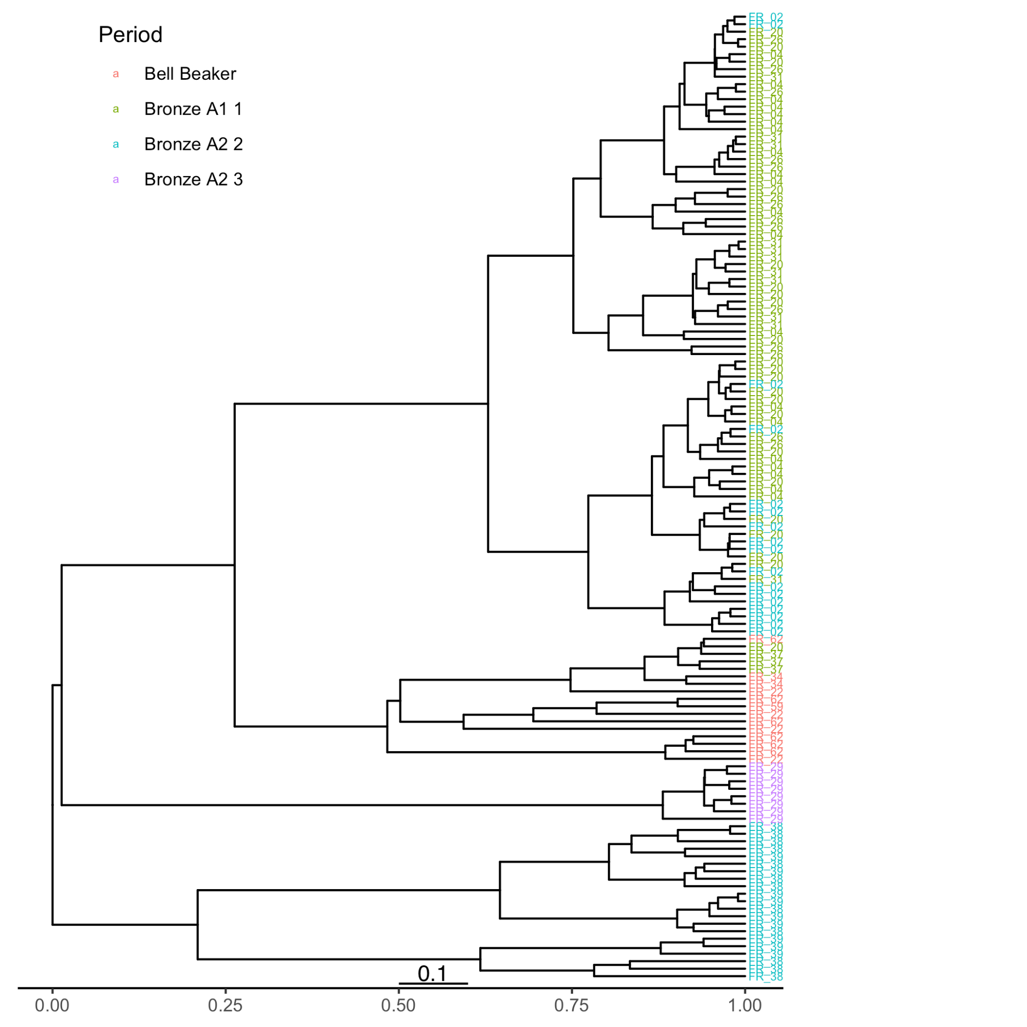
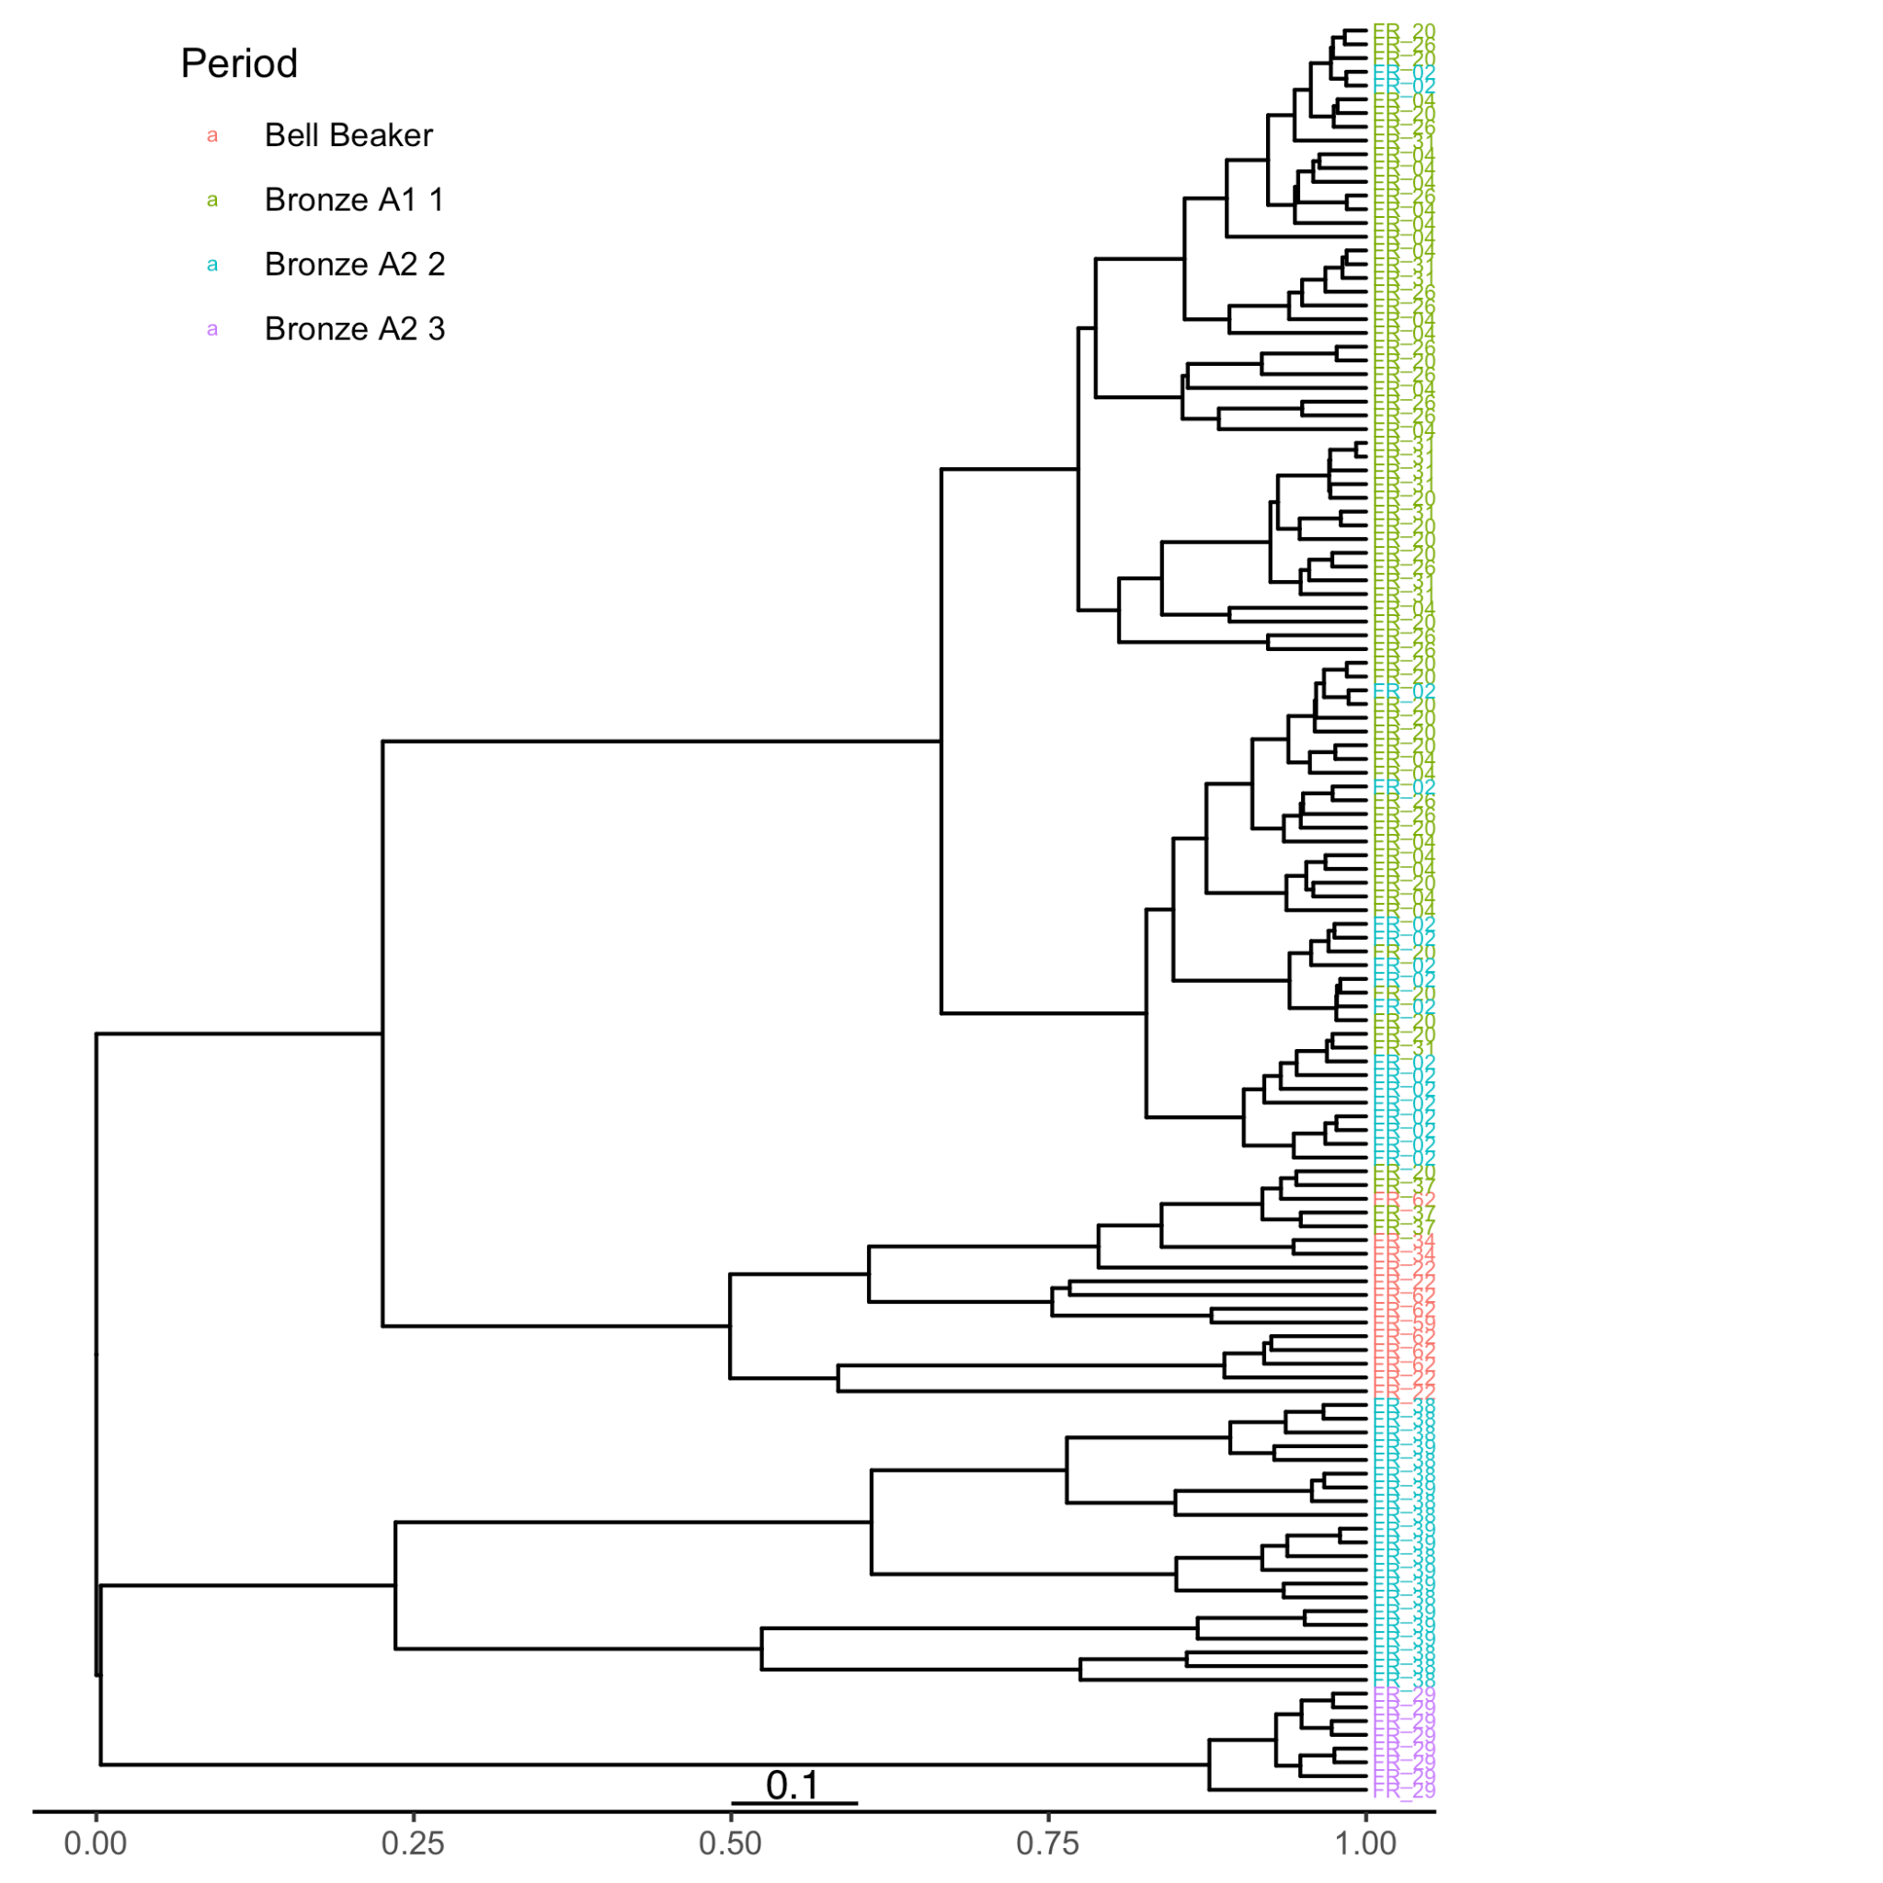
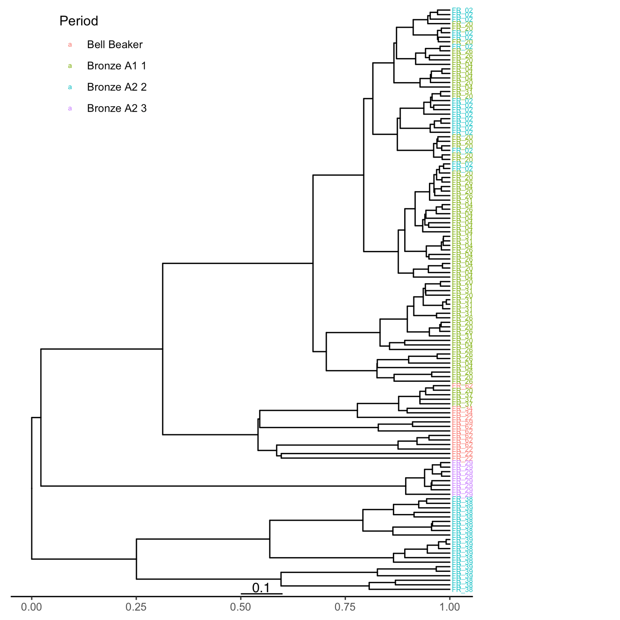
We used a Brownian motion, strict clock, birth-death model
The resulting treespace shows roughly three clusters.
Median trees of each cluster have similar topographies
Notes:
Here’s the basic output from our MCMC process. A treespace plot showing that we have areas of high consensus, and a few other groups of different trees. The median trees near each grouping show pretty similar topology, with the differences mostly tips switching around in the lower clades. Among palaeontologists treespaces are becoming standard exploratory tool in phylogenetic analysis. This is useful for examining solutions and outcomes that are plausible given the model and the data.

Slide 21
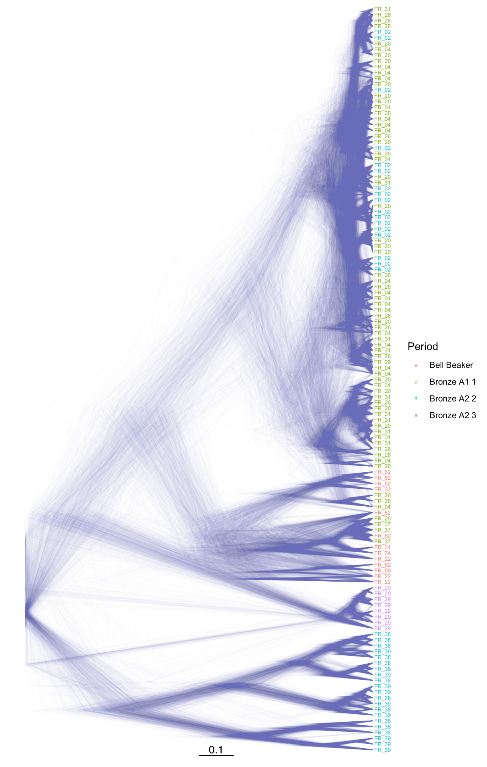
The DensiTree plot on shows the trees kept from the MCMC process.
Fuzzy areas on the tree indicate topological uncertainty, where multiple trees disagree about the relationships between specimens.
Uncertainty might result from incongruous lineages of shape variables, horizontal transfer, independent invention, etc.
Substantial uncertainty in this part
of the
tree
Notes:
The DensiTree plot on the right shows the trees kept from the MCMC process. Fuzzy areas on the tree indicate topological uncertainty, where multiple trees disagree about the relationships between specimens. Uncertainty might result from incongruous lineages of shape variables, horizontal transfer, independent invention. The DensiTree plot method is a stark departure from from the single or small number of maximum parsimony trees that give little insight into how support is distributed across the tree

Slide 22
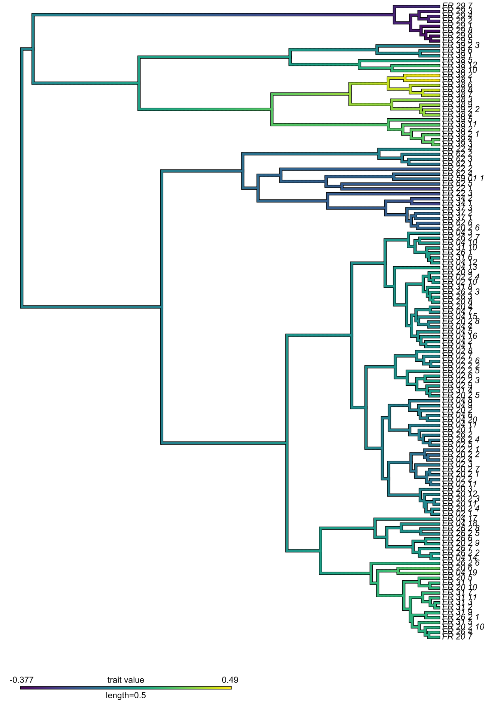
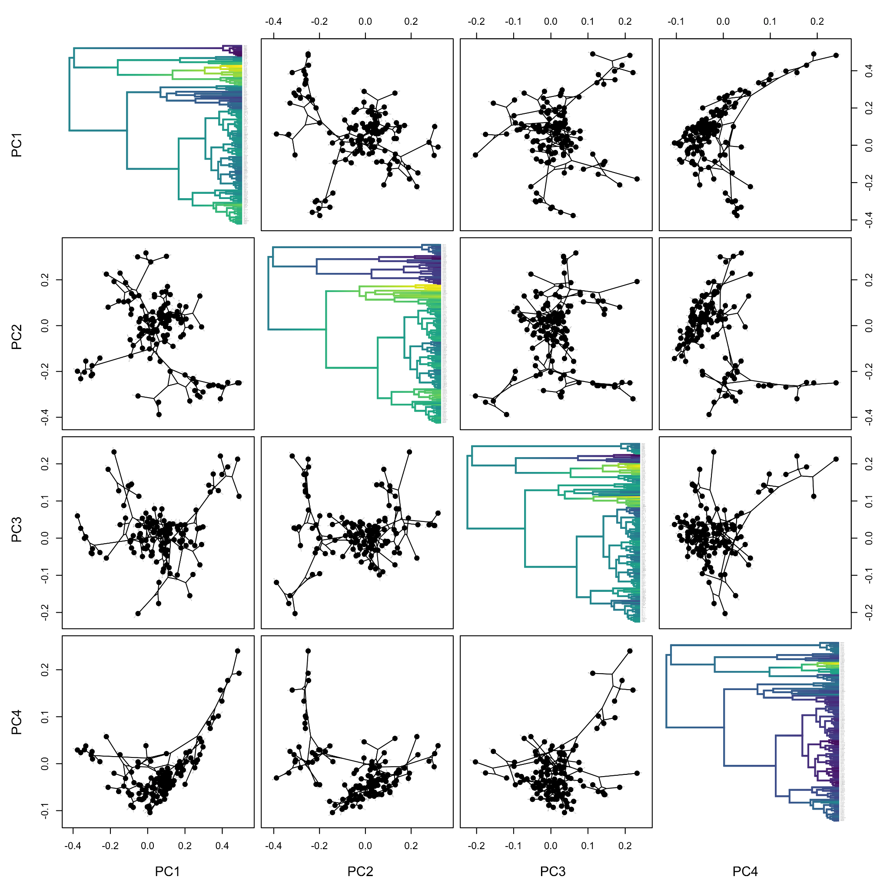
Ancestral state reconstruction relates the character states, in this case, artefact shape, to evolutionary relationships
Tang depth
Shoulder width
Tang height
Tang width
The deep tang and narrow shoulders are characteristic of the older clades
Notes:
Putting the tree to work for us, we can compute ancestral state reconstruction to see how shape variation is distributed across the clades. Here we see that our PC1, deep tang and narrow shoulders, is characteristic of some of the oldest clades. Variation in shoulder width is a later development.

Slide 23
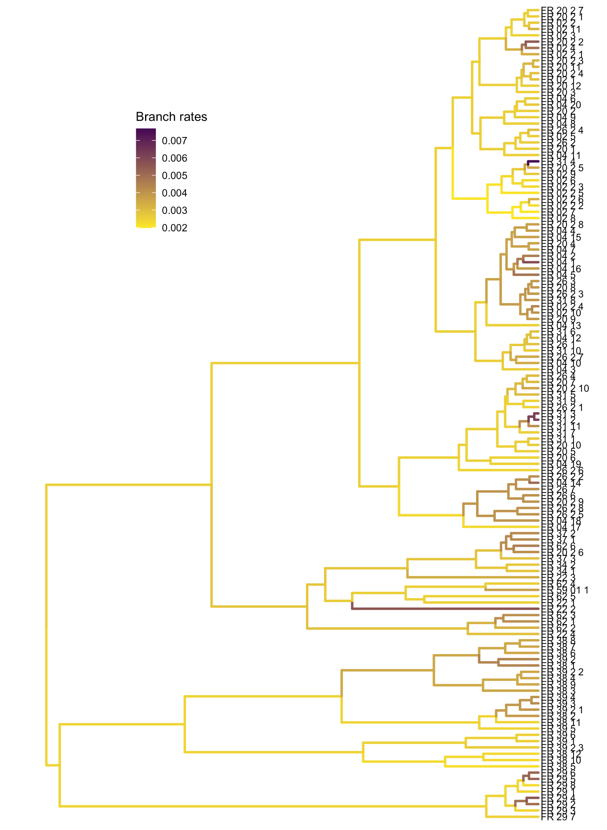
We explored a second model with a relaxed clock to allow branch-specific clock rates of evolution among characters
Rates of evolution are uniformly low, increasing only at distantly related tips, suggesting late bursts of innovation leading up to replacement by metal
Notes:
Further exploration of the tree is possible if we switch from a strict clock to a relaxed clock. Then we can learn something about how rates of change in shape varied across the tree. Here we see rates of evolution were generally uniformly low, increasing only at distantly related tips, suggesting late bursts of innovation leading up to replacement by metal

Slide 24
Conclusions
Continuous characters derived - in large numbers and great detail from GMM - can be used in the construction of cultural phylogenies
Emerging software tools (especially R, RevBayes, and friends) make it possible to conduct such analysis on legacy or original material, to use relatively large datasets and to do all of this FAIRly.
Bayesian methods formalise uncertainty, and present new challenges for model and prior selection; ethnographic and detailed archaeological data on transmission dynamics may help here.
Our case study yields promising results and could be extended with
Larger area/greater sample of the same artefact class
Parallel analyses of other artefact classes from grave good sets (same-gender dynamics) or more generally (whole 'society' transmission dynamics or contrasting transmission across genders),
A phylogenetic/macroevolutionary study of gene-culture co-evolution
Exploration of cultural phylogeography and niche construction dynamics using comparative methods
Notes:
FAIRly -> we have used R and RevBayes, interactive environment for statistical computation in phylogenetics that has it’s own language, Rev, which is very like R. Like the R language, Rev is designed to support interactive analysis. It supports both functional and procedural programming models, and makes a clear distinction between the two. We believe these two tools, R and RevBayes, are an excellent combination to support the exploration of a new frontier of tree-thinking in archaeological science.
F - finable
A - accessible
I - interoperable
R - reusable

